Slide 1
Kaylee Neff, María Auxiliadora Checa Prieto, Maximus Fiumera, and Michael McCarthy
The Rise of Passive Investing and Index Funds

Slide 2
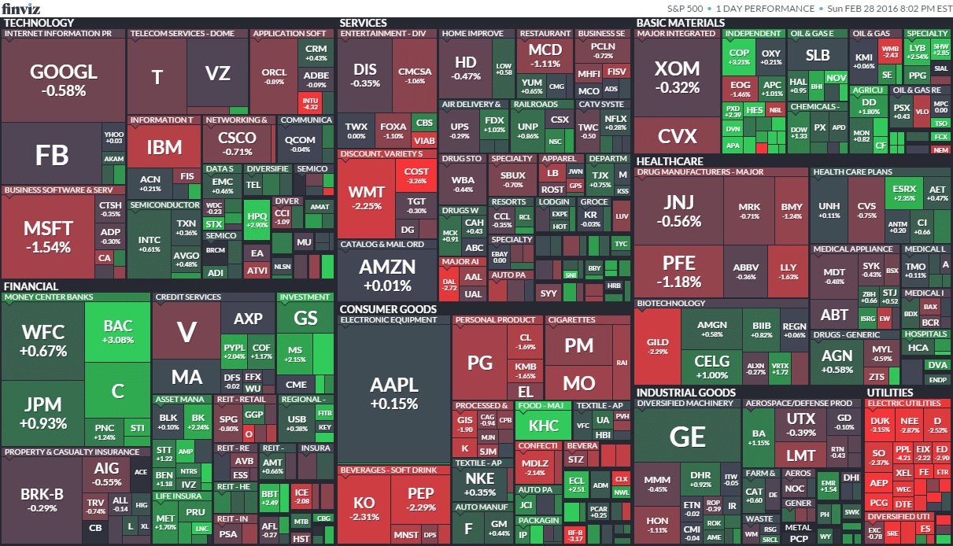
Introduction - topic
What is Passive Investing?
Maximize returns by minimizing trading costs
Goal: match market performance, not beat it
Core concept: diversification and market-matching
Massive Footprint Today:
~⅓ of entire U.S. Market (J.P. Morgan, 2024)
Vast majority of retirement accounts
Central Question:
What are the implications of the shift to passive investing?
Notes:
Passive investing is a strategy that attempts to maximize returns by minimizing trading costs. Passive investors typically buy an investment vehicle like an ETF, which will match a market rather than beating that market. This strategy diversifies the investor’s portfolio over a long period of time, making it ideal for long term investment needs like retirement. The main question that we researched regarding this strategy is: what are the implications of the shift to passive investing on the market and price discovery?

Slide 3
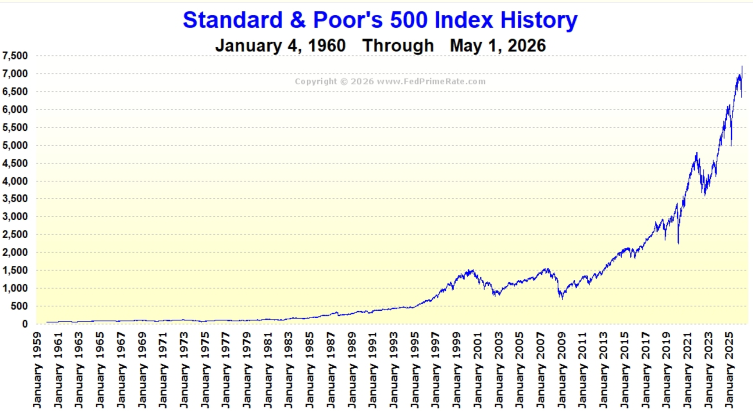
Background & Theory - motivation
Shift in Investor Behavior
Passive vehicles consolidating retail investors (Ryan, 2026)
90% of active traders underperform passive strategies (Moltke & Sløk, 2024)
Evidence of lower liquidity, according to Fed
Theory: Fama’s Efficient Market Hypothesis
Markets efficiently process information
Passive investing captures long-term growth
Supported by long-term data
Conclusion:
Fama’s theory is the foundation that explains passive investing
Notes:
Many investors have recently been shifting towards passive vehicles, such as ETFs and Mutual funds. This is in part because passive investing provides consistently better returns than active trading (in the long run). This concentration of investors into passive vehicles has slightly lowered market liquidity according to the fed, so it clearly does have an effect on the market overall. Passive investing is primarily based on the concepts of diversification and Eugene Fama’s efficient market hypothesis. This theory states that markets are overall efficient, and that it is nearly impossible to outperform them on a long-term basis.

Slide 4
Main Findings - Data (2005-2023)
Table 1:Estimated U.S. Equity Fund Market Share Transition
Year | Approximate Passive U.S. Equity Market Share (%) | Approximate Active U.S. Equity Market Share (%)
2005 | 15% | 85%
2015 | 33% | 67%
2023 | 53% | 47%
Board of Governors of the Federal Reserve System. 2018. Finance and economics discussion series (FEDS) 2018-060. https://www.federalreserve.gov/econres/feds/files/2018060r1pap.pdf
Sushko, V., & Turner, G. 2018. The implications of passive investing for securities markets. Bank for International Settlements. https://www.bis.org/publ/qtrpdf/r_qt1803j.htm
Notes:
This research was found through the Federal Reserve Board and BIS data, it reveals a total reversal of US equity fund market shares. Over the last 20 years, we’ve seen a total flip in how the market operates: passive investing has grown from a small 15% share to a 53% majority. While this is a win for individual investors because it lowers fees and boosts personal returns, it means that for the first time ever, more than half of the money in the market is being invested automatically. This shift from "active picking" to "automated tracking" marks a massive structural change.

Slide 5
Implication
Market Theory
Systemic Impact
EMH Erosion: Reduced "rational" price discovery as index-driven buying overrides fundamentals.
Indiscriminate Flows: Simultaneous purchase of all index stocks regardless of firm health.
Liquidity Risk: Potential for rapid ETF redemptions to trigger index-wide volatility shocks.
Governance: Concentration of voting power in the "Big Three" asset management firms.
Notes:
The shift toward passive investing creates a trade-off: while individuals enjoy lower costs, the financial system becomes more fragile. By buying stocks indiscriminately based on signs rather than performance, passive funds weaken price discovery and undermine the Efficient Market Hypothesis. This trend leads to stocks moving in sync, driven by flows rather than fundamentals. Furthermore, research suggests that sudden ETF redemptions during economic shocks could trigger systemic volatility. Ultimately, we are trading individual savings for increased liquidity risks and a dangerous concentration of corporate voting power.

Slide 6
Discussion
Benefits for Individual Investor
No fees and Out Performance
Systematic Liquidity Risks
Cascading Selling and destabilization
Compromised Price Discovery
Inaccurate Evaluations due to passive products and Less Active Participants
Corporate Governance Concerns
Concentration of Voting Rights
Notes:
The move toward passive management is a double edged sword for the financial industry. While the shift works in favor of the individual investor who stands to benefit from the reduction in fees and enhanced performance, there are also systematically risky elements introduced by the change. The decline in active management means that the market’s price discovery function, which involves integrating information into the value of securities, is becoming weaker. In addition, the sheer size of the ETFs today poses liquidity risks that may lead to volatility in the market during downturns. Lastly, the consolidation of voting rights in corporations under the hands of just three industry giants introduces new governance issues. In which the regulators need to adopt a new strategy and turn their efforts towards mitigating, rather than combating the risks posed by passive investment.

Slide 7
Conclusion
Key findings
Passive investing now dominates U.S. equity markets
Reduced role of active investors
Changes in price discovery and market dynamics
Main Argument
Passive investing benefits individual investors (low cost, diversification)
May weaken market efficiency and increase systemic risk
Implications
Need balance between active and passive investing
Potential risks: volatility, liquidity, ownership concentration
Regulators should strengthen market resilience

Slide 8
References
Chen, J. (n.d.). Passive Investing: Definition, Pros and Cons, vs. Active Investing. Investopedia. Retrieved April 21, 2026, from https://www.investopedia.com/terms/p/passiveinvesting.asp
J.P. Morgan. (2024, October 22). ETF Market Guide: Trends and Themes to Watch. J.P. Morgan. Retrieved April 21, 2026, from https://www.jpmorgan.com/insights/global-research/investing/etf-guide
Logue, A. C. (n.d.). Are markets efficient? How Eugene Fama kicked off a controversy. Encyclopedia Britannica. Retrieved April 21, 2026, from Are markets efficient? How Eugene Fama kicked off a controversy
Moltke, F. V., & Sløk, T. (2024, November 4). Assessing the Impact of Passive Investing over Time: Higher Volatility, Reduced Liquidity, and Increased Concentration.
Ryan, E. (2026, January 23). Closing time: How passive investing is reshaping equity market microstructure. State Street Global Advisors. Retrieved April 21, 2026, from https://www.ssga.com/us/en/institutional/insights/how-passive-investing-reshaping-microstructure
Anadu, K., Kruttli, M., McCabe, P., & Osambela, E. 2018. The shift from active to passive investing: Potential risks to financial stability? Finance and Economics Discussion Series 2018-060. Board of Governors of the Federal Reserve System.
Board of Governors of the Federal Reserve System. 2018. Finance and economics discussion series (FEDS) 2018-060. https://www.federalreserve.gov/econres/feds/files/2018060r1pap.pdf
Morningstar. Active vs. passive investing. https://www.morningstar.com/business/insights/blog/active-vs-passive-investing
Sushko, V., & Turner, G. 2018. The implications of passive investing for securities markets. Bank for International Settlements. https://www.bis.org/publ/qtrpdf/r_qt1803j.htm

